Slide 1

NAME: PEDDA GIRIDHAR
ROLL NO: 23ME5A0516
COLLEGE NAME: RAMACHANDRA COLLEGE OF ENGINEERING
COLLEGE STATE: ANDHRA PRADESH, ELURU
SKILL BUILD ID: giridharpedda@gmail.com
DOMAIN: ARTIFICIAL INTELLIGENCE
START DATE: 3RD JUNE 2024
END DATE: 15TH JULY 2024

Slide 2

EMPLOYEE BURNOUT ANALYSIS AND PREDICTION
Employee burnout, characterized by emotional exhaustion, depersonalization, and a sense of reduced personal accomplishment, significantly impacts both individual well-being and organizational performance. Analyzing and predicting burnout involves using surveys, interviews, and data analytics to identify risk factors such as excessive workload, lack of support, and prolonged stress. By implementing preventive measures like workload management, flexible working conditions, and wellness programs, organizations can mitigate burnout, enhance employee satisfaction, and improve overall productivity.

Slide 3
AGENDA
1. Define employee burnout and its key characteristics.
2. Discuss the importance of analyzing employee burnout.
3. Outline methods for analyzing employee burnout.
4. Identify key metrics for burnout analysis.
5. Explain predictive analytics for forecasting burnout.
6. Highlight strategies for preventing and mitigating burnout.

Slide 4

PROJECT OVERVIEW
Employee burnout, marked by emotional exhaustion, depersonalization, and reduced personal accomplishment, can significantly affect individual well-being and organizational productivity. To address this, companies need to analyze burnout through surveys, interviews, and observational methods, focusing on metrics like absenteeism and engagement scores. Predictive analytics can help forecast burnout by using historical data and machine learning to identify at-risk employees. Preventive strategies, such as workload management, flexible working conditions, supportive environments, and wellness programs, are crucial for mitigating burnout and promoting a healthier, more productive workforce.

Slide 5
THE END USERS OF THIS PROJECT
1. Human Resources (HR) Professionals: They use the insights to develop and implement policies to mitigate burnout and improve employee well-being.
2. Managers and Supervisors: They utilize the data to adjust workloads, provide support, and foster a positive work environment.
3. Executives and Leadership Teams: They leverage the information for strategic decision-making to enhance overall organizational performance and culture.
4. Employees: They benefit from improved workplace conditions, better support systems, and initiatives aimed at reducing burnout.
5. Occupational Health Specialists: They use the data to design and implement health and wellness programs.
6. Data Analysts: They work on collecting, processing, and analyzing data to provide actionable insights on burnout trends.
7. Organizational Development Consultants: They use the analysis to advise on improving organizational structures and processes to prevent burnout.

Slide 6
SOLUTION AND ITS VALUE PROPOSITION
The comprehensive Employee Burnout Analysis and Prediction System offers a robust solution to mitigate burnout and enhance employee well-being. By leveraging data from surveys, interviews, and real-time monitoring, the system employs predictive analytics to identify employees at risk of burnout. This proactive approach enables HR and management to implement targeted interventions such as workload management, flexible work arrangements, wellness programs, and professional development opportunities. The value proposition includes improved employee health and satisfaction, increased productivity, lower turnover rates, and a positive workplace culture. Additionally, the system supports data-driven decision-making, providing a competitive advantage and significant cost savings by reducing absenteeism, healthcare expenses, and lost productivity.

Slide 7
CUSTOMIZE THE PROJECT AND MAKE IT OWN
Tailored Data Collection: Customized surveys and questionnaires were developed to gather relevant data specific to the organization’s culture and employee demographics. Interviews and focus groups were conducted to gain deeper qualitative insights.
Customized Predictive Model: The predictive analytics model was fine-tuned using the organization’s historical data, ensuring the algorithms accurately identify burnout risk factors unique to the company’s work environment and industry.
Integration with Existing Systems: The system was integrated with existing HR and productivity tools, enabling seamless data collection and analysis. This integration ensured that real-time monitoring of key metrics such as work hours and engagement scores could be easily implemented.
Personalized Dashboards and Reports: Customizable dashboards and reports were created to provide HR and management with actionable insights tailored to their specific needs. This included features like drill-down capabilities to explore data at various levels of detail.
Employee Engagement Initiatives: In addition to predictive analytics, initiatives were launched to enhance overall employee engagement. This included recognition programs, team-building activities, and regular communication forums to foster a supportive and positive work environment.

Slide 8
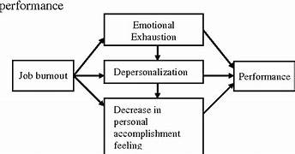
MODELLING
The modeling of employee burnout analysis and prediction involves several critical steps to ensure accurate and actionable insights. First, comprehensive data is collected from sources such as employee surveys, HR records, workload logs, and engagement scores. This data undergoes preprocessing, including cleaning, feature engineering, and normalization. Exploratory Data Analysis (EDA) follows, using statistical summaries and visualizations to understand data distributions and relationships. Various machine learning models, such as logistic regression, decision trees, and neural networks, are then selected and trained using techniques like cross-validation and hyperparameter tuning. The models are evaluated based on metrics like accuracy, precision, recall, F1 score, and ROC-AUC to ensure robust performance. Finally, the optimized model is integrated into the organization's HR system, enabling real-time monitoring and proactive interventions to mitigate employee burnout and enhance overall well-being.

Slide 9
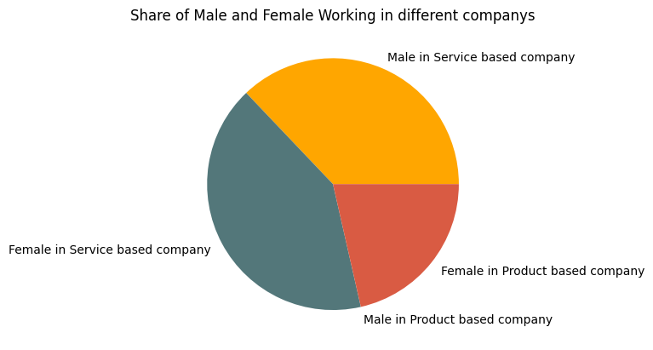
RESULTS
Implementing an employee burnout analysis and prediction system delivers significant benefits. It enables early detection of burnout risks, leading to timely interventions that enhance employee well-being and productivity. By reducing turnover rates and associated costs, organizations foster a positive culture of support and loyalty. Strategically, the system empowers informed decision-making and resource allocation, ensuring sustained organizational health and success.

Slide 10
LINKS
https://github.com/Pedd981/Employee-burnout-analysis-and-prediction

Slide 11
THANK YOU
PEDDA GIRIDHAR

